Slide 1
SENIOR PROJECT
“Quantum Computation : Implementation of Quantum Gates on Linux Clusters”
Arda Karaduman
9922031

Slide 2
History of Quantum Computation
First proposed by R. Feynman and Benioff (1982)
First motivations was to simulate quantum systems and miniaturisation
Deutsch showed the power of quantum parallelism (1985)
Shor discovered an algorithm for prime factorisation (1994)
Grover discovered an algorithm for fast searching of a database (1996)

Slide 3
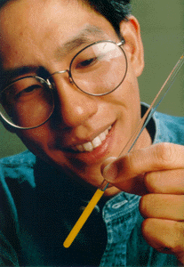
Implementations
Dr. Isaac Chuang, research staff member at IBM's Almaden Research holding a 5 bit quantum computer in his hand
Shor’s algorithm and Grover’s algorithm was implemented succesfuly on 5 qubit and 7 qubit quantum computers

Slide 4
Physical Background
Relies on Qubits
A qubit can be in a weighted combination (superposition) of both 0 and 1 at the same time
The exact state of a qubit is represented with probability amplitudes
Algorithms work by manipulating these probabilities and giving the qubit which is associated with the correct answer, highest probability

Slide 5


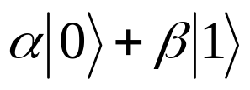



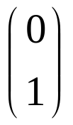
Mathematical Basics (Dirac Notation)
Quantum zero is represented with the notation
Similarly Quantum one is represented as
The state of a qubit is represented as
where α and β are probability amplitudes, which are complex numbers. When we measure this qubit, we see
with probability and , with probability
A qubit with state , which is guaranteed to read 0 when measured, may also be represented by the vector
and a qubit with state may also be represented with the vector

Slide 6

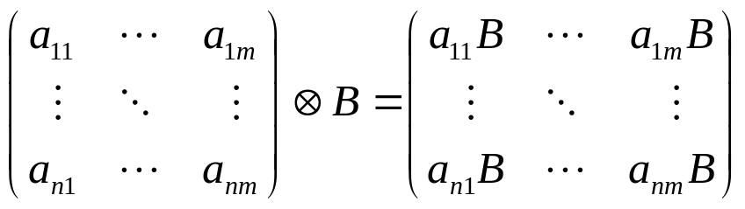
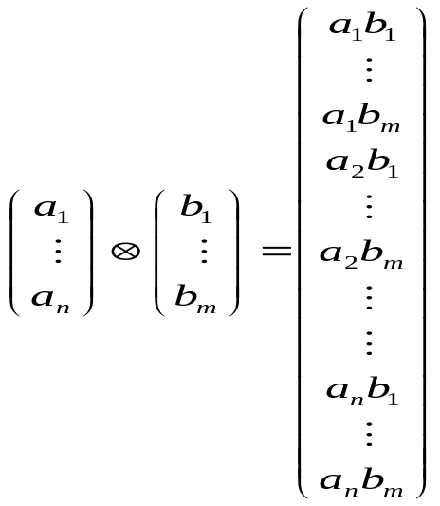
The state of a register consisting of n qubits is represented by the tensor product ( ) of the individual states of the qubits in it.
For two matrices A and B, A B equals
So the tensor product of two vectors a and b equals

Slide 7

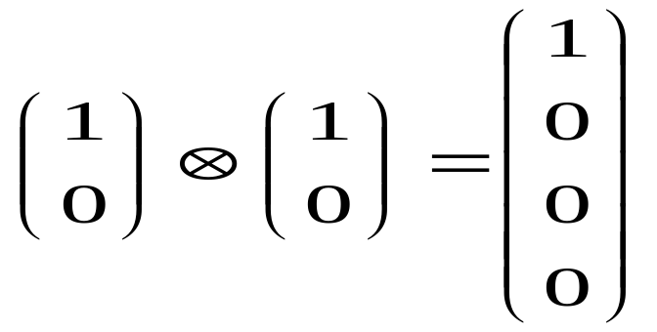

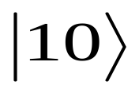

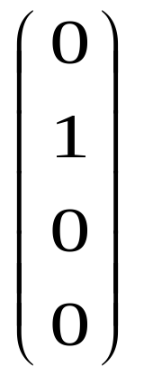
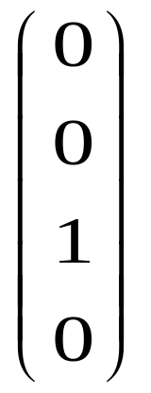
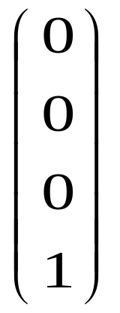
So if we have two qubits in a register, the state where both bits are can be represented as
which corresponds to the vector
Similarly, , , correspond to the vectors respectively

Slide 8
A Quantum register which consists of n qubits can be expressed as a 2^{n} dimensional vector of complex numbers with length 1
State | Amplitude (a+ib) | Probability (a²+b²)
000 | 0.37 + i 0.04 | 0.14
001 | 0.11 + i 0.18 | 0.04
010 | 0.09 + i 0.31 | 0.10
011 | 0.30 + i 0.30 | 0.18
100 | 0.35 + i 0.43 | 0.31
101 | 0.40 + i 0.01 | 0.16
110 | 0.09 + i 0.12 | 0.02
111 | 0.15 + i 0.16 | 0.05

Slide 9
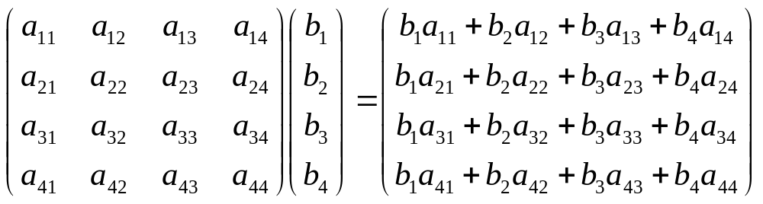
A quantum program which transforms a register of n qubits from an input state to an output state can be represented as a 2^{n} by 2^{n} matrix, which, when multiplied by the input state vector, gives the output state vector.
Input
State
Vector
Quantum Program
Output State Vector

Slide 10
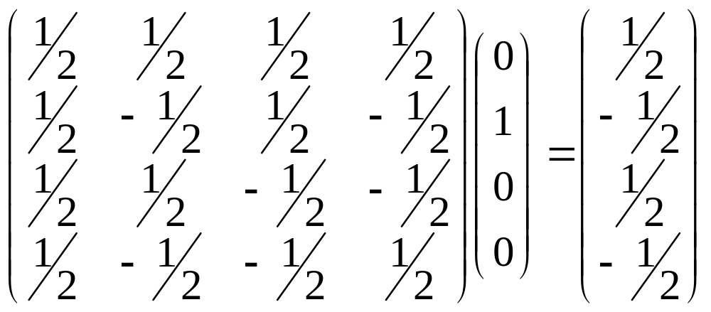
Applying Hadamard gate to a qubit which contains

Slide 11
Parallelisation Strategy
Each processor should keep a copy of the input vector
We can distribute the Quantum Program row by row to processors
We have to obtain each row of output vector from the processors seperately
P1 | b₁ * a₁₁ | b₂ * a₁₂ | b₃ * a₁₃ | b₄ * a₁₄
P2 | b₁ * a₂₁ | b₂ * a₂₂ | b₃ * a₂₃ | b₄ * a₂₄
P3 | b₁ * a₃₁ | b₂ * a₃₂ | b₃ * a₃₃ | b₄ * a₃₄
P4 | b₁ * a₄₁ | b₂ * a₄₂ | b₃ * a₄₃ | b₄ * a₄₄

Slide 12
The bulk of the computation should be distributed evenly to all worker nodes (in this case, the inidividual elements of the output vector)
The output vector will become the input vector for the next program, so each node in the cluster should have it.

Slide 13
Implementation Report
Basic Matrix operations have been implemented
Linux cluster was built and configured
Code for parallel cluster was written and executed for the Hadamard gate
The output vector was transmitted to all nodes successfully

Slide 14
Conclusion – Future work
Implement basic quantum gates, Toffoli, CNOT gate, Quantum Fourrier Transform
Compare performance results with sequential implementations
Implement important algorithms such as Shor’s algorithm

